Slide 1
How Do We Find Regulatory Motifs in DNA? Greedy and Randomized Algorithms
Phillip Compeau and Pavel Pevzner.
Bioinformatics Algorithms: An Active Learning Approach
©2013 by Compeau and Pevzner. All rights reserved.

Slide 2
Outline
From Implanted Patterns to Regulatory Motifs
Implanting Patterns into Strings
Do We Have a Clock Gene?
Implanted Motif Problem
Motif Finding Problem (Music Break)
Median String Problem
Greedy Motif Search
How Rolling Dice Helps Us Find Regulatory Motifs
Randomized Motif Search
How do Bacteria Hibernate?
Gibbs Sampling
Pseudocounts

Slide 3
Generate Ten Random Sequences
atgaccgggatactgataccgtatttggcctaggcgtacacattagataaacgtatgaagtacgttagactcggcgccgccg acccctattttttgagcagatttagtgacctggaaaaaaaatttgagtacaaaacttttccgaatactgggcataaggtaca tgagtatccctgggatgacttttgggaacactatagtgctctcccgatttttgaatatgtaggatcattcgccagggtccga gctgagaattggatgaccttgtaagtgttttccacgcaatcgcgaaccaacgcggacccaaaggcaagaccgataaaggaga tcccttttgcggtaatgtgccgggaggctggttacgtagggaagccctaacggacttaatggcccacttagtccacttatag gtcaatcatgttcttgtgaatggatttttaactgagggcatagaccgcttggcgcacccaaattcagtgtgggcgagcgcaa cggttttggcccttgttagaggcccccgtactgatggaaactttcaattatgagagagctaatctatcgcgtgcgtgttcat aacttgagttggtttcgaaaatgctctggggcacatacaagaggagtcttccttatcagttaatgctgtatgacactatgta ttggcccattggctaaaagcccaacttgacaaatggaagatagaatccttgcatttcaacgtatgccgaaccgaaagggaag ctggtgagcaacgacagattcttacgtgcattagctcgcttccggggatctaatagcacgaagcttctgggtactgatagca

Slide 4
Implant a Pattern AAAAAAAGGGGGGG at Randomly Chosen Positions
atgaccgggatactgatAAAAAAAAGGGGGGGggcgtacacattagataaacgtatgaagtacgttagactcggcgccgccg acccctattttttgagcagatttagtgacctggaaaaaaaatttgagtacaaaacttttccgaataAAAAAAAAGGGGGGGa tgagtatccctgggatgacttAAAAAAAAGGGGGGGtgctctcccgatttttgaatatgtaggatcattcgccagggtccga gctgagaattggatgAAAAAAAAGGGGGGGtccacgcaatcgcgaaccaacgcggacccaaaggcaagaccgataaaggaga tcccttttgcggtaatgtgccgggaggctggttacgtagggaagccctaacggacttaatAAAAAAAAGGGGGGGcttatag gtcaatcatgttcttgtgaatggatttAAAAAAAAGGGGGGGgaccgcttggcgcacccaaattcagtgtgggcgagcgcaa cggttttggcccttgttagaggcccccgtAAAAAAAAGGGGGGGcaattatgagagagctaatctatcgcgtgcgtgttcat aacttgagttAAAAAAAAGGGGGGGctggggcacatacaagaggagtcttccttatcagttaatgctgtatgacactatgta ttggcccattggctaaaagcccaacttgacaaatggaagatagaatccttgcatAAAAAAAAGGGGGGGaccgaaagggaag ctggtgagcaacgacagattcttacgtgcattagctcgcttccggggatctaatagcacgaagcttAAAAAAAAGGGGGGGa

Slide 5
Where Are the Implanted Patterns Hiding?
atgaccgggatactgataaaaaaaagggggggggcgtacacattagataaacgtatgaagtacgttagactcggcgccgccg acccctattttttgagcagatttagtgacctggaaaaaaaatttgagtacaaaacttttccgaataaaaaaaaaggggggga tgagtatccctgggatgacttaaaaaaaagggggggtgctctcccgatttttgaatatgtaggatcattcgccagggtccga gctgagaattggatgaaaaaaaagggggggtccacgcaatcgcgaaccaacgcggacccaaaggcaagaccgataaaggaga tcccttttgcggtaatgtgccgggaggctggttacgtagggaagccctaacggacttaataaaaaaaagggggggcttatag gtcaatcatgttcttgtgaatggatttaaaaaaaaggggggggaccgcttggcgcacccaaattcagtgtgggcgagcgcaa cggttttggcccttgttagaggcccccgtaaaaaaaagggggggcaattatgagagagctaatctatcgcgtgcgtgttcat aacttgagttaaaaaaaagggggggctggggcacatacaagaggagtcttccttatcagttaatgctgtatgacactatgta ttggcccattggctaaaagcccaacttgacaaatggaagatagaatccttgcataaaaaaaagggggggaccgaaagggaag ctggtgagcaacgacagattcttacgtgcattagctcgcttccggggatctaatagcacgaagcttaaaaaaaaggggggga
The implanted patterns can be found by the Frequent Words algorithm.

Slide 6
Implant a Pattern AAAAAAGGGGGGG with 4 Random Mutations at Random Positions
atgaccgggatactgatAgAAgAAAGGttGGGggcgtacacattagataaacgtatgaagtacgttagactcggcgccgccg acccctattttttgagcagatttagtgacctggaaaaaaaatttgagtacaaaacttttccgaatacAAtAAAAcGGcGGGa tgagtatccctgggatgacttAAAAtAAtGGaGtGGtgctctcccgatttttgaatatgtaggatcattcgccagggtccga gctgagaattggatgcAAAAAAAGGGattGtccacgcaatcgcgaaccaacgcggacccaaaggcaagaccgataaaggaga tcccttttgcggtaatgtgccgggaggctggttacgtagggaagccctaacggacttaatAtAAtAAAGGaaGGGcttatag gtcaatcatgttcttgtgaatggatttAAcAAtAAGGGctGGgaccgcttggcgcacccaaattcagtgtgggcgagcgcaa cggttttggcccttgttagaggcccccgtAtAAAcAAGGaGGGccaattatgagagagctaatctatcgcgtgcgtgttcat aacttgagttAAAAAAtAGGGaGccctggggcacatacaagaggagtcttccttatcagttaatgctgtatgacactatgta ttggcccattggctaaaagcccaacttgacaaatggaagatagaatccttgcatActAAAAAGGaGcGGaccgaaagggaag ctggtgagcaacgacagattcttacgtgcattagctcgcttccggggatctaatagcacgaagcttActAAAAAGGaGcGGa
A (k,d)-motif: a k-mer that appears in each sequence with at most d mismatches. AAAAAAGGGGGGG is a (13,4)-motif

Slide 7
Now Where are the Implanted Patterns?
atgaccgggatactgatagaagaaaggttgggggcgtacacattagataaacgtatgaagtacgttagactcggcgccgccg acccctattttttgagcagatttagtgacctggaaaaaaaatttgagtacaaaacttttccgaatacaataaaacggcggga tgagtatccctgggatgacttaaaataatggagtggtgctctcccgatttttgaatatgtaggatcattcgccagggtccga gctgagaattggatgcaaaaaaagggattgtccacgcaatcgcgaaccaacgcggacccaaaggcaagaccgataaaggaga tcccttttgcggtaatgtgccgggaggctggttacgtagggaagccctaacggacttaatataataaaggaagggcttatag gtcaatcatgttcttgtgaatggatttaacaataagggctgggaccgcttggcgcacccaaattcagtgtgggcgagcgcaa cggttttggcccttgttagaggcccccgtataaacaaggagggccaattatgagagagctaatctatcgcgtgcgtgttcat aacttgagttaaaaaatagggagccctggggcacatacaagaggagtcttccttatcagttaatgctgtatgacactatgta ttggcccattggctaaaagcccaacttgacaaatggaagatagaatccttgcatactaaaaaggagcggaccgaaagggaag ctggtgagcaacgacagattcttacgtgcattagctcgcttccggggatctaatagcacgaagcttactaaaaaggagcgga
Would the Frequent Words algorithm find this hidden message?

Slide 8

Why Would a Biologist Care?
atgaccgggatactgatagaagaaaggttgggggcgtacacattagataaacgtatgaagtacgttagactcggcgccgccg acccctattttttgagcagatttagtgacctggaaaaaaaatttgagtacaaaacttttccgaatacaataaaacggcggga tgagtatccctgggatgacttaaaataatggagtggtgctctcccgatttttgaatatgtaggatcattcgccagggtccga gctgagaattggatgcaaaaaaagggattgtccacgcaatcgcgaaccaacgcggacccaaaggcaagaccgataaaggaga tcccttttgcggtaatgtgccgggaggctggttacgtagggaagccctaacggacttaatataataaaggaagggcttatag gtcaatcatgttcttgtgaatggatttaacaataagggctgggaccgcttggcgcacccaaattcagtgtgggcgagcgcaa cggttttggcccttgttagaggcccccgtataaacaaggagggccaattatgagagagctaatctatcgcgtgcgtgttcat aacttgagttaaaaaatagggagccctggggcacatacaagaggagtcttccttatcagttaatgctgtatgacactatgta ttggcccattggctaaaagcccaacttgacaaatggaagatagaatccttgcatactaaaaaggagcggaccgaaagggaag ctggtgagcaacgacagattcttacgtgcattagctcgcttccggggatctaatagcacgaagcttactaaaaaggagcgga
Would the Frequent Words algorithm find this hidden message?

Slide 9
Outline
From Implanted Patterns to Regulatory Motifs
Implanting Patterns into Strings
Do We Have a Clock Gene?
Implanted Motif Problem
Motif Finding Problem (Music Break)
Median String Problem
Greedy Motif Search
How Rolling Dice Helps Us Find Regulatory Motifs
Randomized Motif Search
How do Bacteria Hibernate?
Gibbs Sampling
Pseudocounts

Slide 10
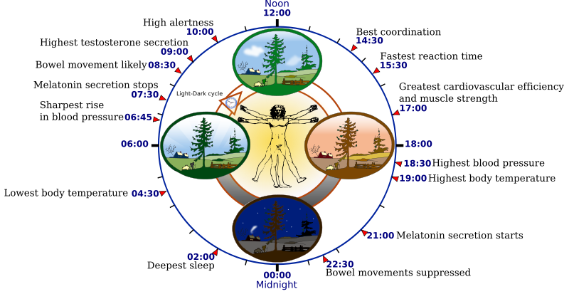
Circadian Clock
Our schedules are controlled by a molecular timekeeper called the circadian clock.
How does each cell in our body know when it should decrease or increase
gene expression of circadian genes?

Slide 11


How do Plants Know Whether it is Day or Night?
Plants need to change gene expression of 1000+ genes (photosynthesis, flowering, frost resistance, etc.) switching from day to night and vice-versa.
Night Blooming Cereus
only blooms at night
Who are the “molecular managers”
telling genes to switch expression on and
off in billions of cells?
Just 3 genes call the shots:
CCA1, LCY, and TOC1.
Sunflower
follows the sun

Slide 12
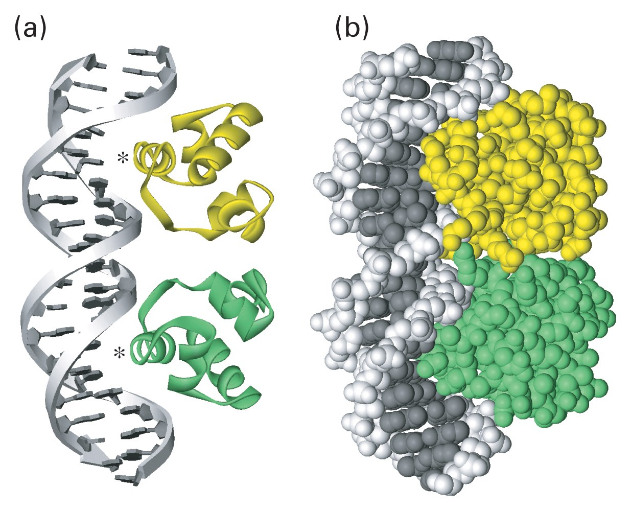
Transcription Factors and Their Binding Sites
CCA1, LCY, and TOC1 are regulatory proteins (a.k.a. transcription factors) control other genes by binding to short DNA fragments (transcription factor binding sites) in the upstream regions of these genes.

Slide 13
Transcription Factors Bind to Their Binding Sites
CCA1
CCA1
CCA1
CCA1
Gene1
Gene2
Gene3
Gene4

Slide 14
How Does CCA1 Know Where to Bind?
CCA1
CCA1
CCA1
CCA1
Gene1
Gene2
Gene3
Gene4
There must be some hidden messages in these regions that tells CCA1 WHERE to bind.

Slide 15
Transcription Factor Binding Sites
cagtATAAAGTCTactgatgcaacctgactcatgacgaggaa
Gene1
agtcgactgacttAACAAATCTcggatcgattcgtccgagga
Gene2
cgtcagctctgtcgggattcgccccgtattcAAAAAAGCTac
Gene3
accgtctccACAAAACCTgctcgtgccactgatgcaacctga
Gene4
The hidden messages (motif AAAAAATCT):
transcription factor binding sites of CCA1

Slide 16
Where are the Hidden Messages Hiding?
cagtataaagtctactgatgcaacctgactcatgacgaggaa
Gene1
agtcgactgacttaacaaatctcggatcgattcgtccgagga
Gene2
cgtcagctctgtcgggattcgccccgtattcaaaaaagcac
Gene3
accgtctccacaaaacctgctcgtgccactgatgcaacctga
Gene4

Slide 17
Outline
From Implanted Patterns to Regulatory Motifs
Implanting Patterns into Strings
Do We Have a Clock Gene?
Implanted Motif Problem
Motif Finding Problem (Music Break)
Median String Problem
Greedy Motif Search
How Rolling Dice Helps Us Find Regulatory Motifs
Randomized Motif Search
How do Bacteria Hibernate?
Gibbs Sampling
Pseudocounts

Slide 18
Randomly Implant AAAAAAGGGGGGG with 4 Random Mutations at 4 Random Positions
atgaccgggatactgatAgAAgAAAGGttGGGggcgtacacattagataaacgtatgaagtacgttagactcggcgccgccg acccctattttttgagcagatttagtgacctggaaaaaaaatttgagtacaaaacttttccgaatacAAtAAAAcGGcGGGa tgagtatccctgggatgacttAAAAtAAtGGaGtGGtgctctcccgatttttgaatatgtaggatcattcgccagggtccga gctgagaattggatgcAAAAAAAGGGattGtccacgcaatcgcgaaccaacgcggacccaaaggcaagaccgataaaggaga tcccttttgcggtaatgtgccgggaggctggttacgtagggaagccctaacggacttaatAtAAtAAAGGaaGGGcttatag gtcaatcatgttcttgtgaatggatttAAcAAtAAGGGctGGgaccgcttggcgcacccaaattcagtgtgggcgagcgcaa cggttttggcccttgttagaggcccccgtAtAAAcAAGGaGGGccaattatgagagagctaatctatcgcgtgcgtgttcat aacttgagttAAAAAAtAGGGaGccctggggcacatacaagaggagtcttccttatcagttaatgctgtatgacactatgta ttggcccattggctaaaagcccaacttgacaaatggaagatagaatccttgcatActAAAAAGGaGcGGaccgaaagggaag ctggtgagcaacgacagattcttacgtgcattagctcgcttccggggatctaatagcacgaagcttActAAAAAGGaGcGGa
Would the Frequent Words algorithm find this (15,4) motif?

Slide 19
Implanted Motifs Problem
Implanted Motif Problem. Finding (k,d)-motifs in a set of strings.
Input: A set of strings Dna, and integers k (motif length) and d (maximal number of mismatches in a motif).
Output: All (k,d)-motifs in Dna.
Should we explore ALL 4^{k} k-mers to solve the Implanted Motif Problem?

Slide 20

Resorting to Motif Enumeration Instead
MotifEnumeration(Dna, k, d)
for each k-mer a in Dna
for each k-mer a’ differing from a by at most d mutations
if a’ is a (k,d)-mer
output a’
Would this simple (albeit slow) algorithm work for finding real biological motifs?
MotifEnumeration assumes that EACH sequence has a k-mer similar to an (unknown) implanted pattern. This condition does not hold for noisy biological datasets.
Notes:
(n – k + 1) * c(k, d)* 4^d * (n – k + 1) * (t - 1)
(n – k + 1) * k^d * 4^d * (n – k + 1) * (t - 1)

Slide 21
Outline
From Implanted Patterns to Regulatory Motifs
Implanting Patterns into Strings
Do We Have a Clock Gene?
Implanted Motif Problem
Motif Finding Problem (Music Break)
Median String Problem
Greedy Motif Search
How Rolling Dice Helps Us Find Regulatory Motifs
Randomized Motif Search
How do Bacteria Hibernate?
Gibbs Sampling
Pseudocounts

Slide 22
From Motifs to a Consensus String
T C G G G G g T T T t t
c C G G t G A c T T a C
a C G G G G A T T T t C
T t G G G G A c T T t t
a a G G G G A c T T C C
T t G G G G A c T T C C
T C G G G G A T T c a t
T C G G G G A T T c C t
T a G G G G A a c T a C
T C G G G t A T a a C C
Motifs

Slide 23
From Motifs to a Consensus String
T C G G G G g T T T t t
c C G G t G A c T T a C
a C G G G G A T T T t C
T t G G G G A c T T t t
a a G G G G A c T T C C
T t G G G G A c T T C C
T C G G G G A T T c a t
T C G G G G A T T c C t
T a G G G G A a c T a C
T C G G G t A T a a C C
Motifs

Slide 24
From Motifs to a Consensus String
T C G G G G g T T T t t
c C G G t G A c T T a C
a C G G G G A T T T t C
T t G G G G A c T T t t
a a G G G G A c T T C C
T t G G G G A c T T C C
T C G G G G A T T c a t
T C G G G G A T T c C t
T a G G G G A a c T a C
T C G G G t A T a a C C
Motifs
Motif Logo

Slide 25
From Motifs to a Consensus String
T C G G G G g T T T t t
c C G G t G A c T T a C
a C G G G G A T T T t C
T t G G G G A c T T t t
a a G G G G A c T T C C
T t G G G G A c T T C C
T C G G G G A T T c a t
T C G G G G A T T c C t
T a G G G G A a c T a C
T C G G G t A T a a C C
Motifs
Consensus(Motifs)
T C G G G G A T T T C C
Motif Logo

Slide 26
From Motifs to a Consensus String
T C G G G G g T T T t t
c C G G t G A c T T a C
a C G G G G A T T T t C
T t G G G G A c T T t t
a a G G G G A c T T C C
T t G G G G A c T T C C
T C G G G G A T T c a t
T C G G G G A T T c C t
T a G G G G A a c T a C
T C G G G t A T a a C C
Motifs
Consensus(Motifs)
T C G G G G A T T T C C
Motif Logo
Score(Motifs)
7 + 6 + 10 + 10 + 9 + 9 + 9 + 5 + 8 + 7 + 4 + 6 = 90
Score(Motifs): # of uppercase letters in motif matrix

Slide 27
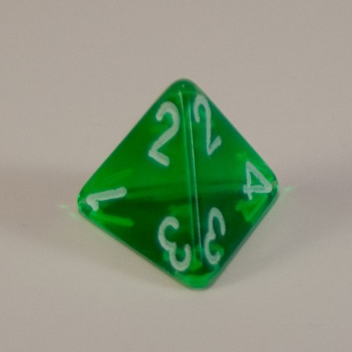
Entropy of a Motif
A: .2 .2 0 0 0 0 .9 .1 .1 .1 .3 0
C: .1 .6 0 0 0 0 0 .4 .1 .2 .4 .6
Profile G: 0 0 1 1 .9 .9 .1 0 0 0 0 0
T: .7 .2 0 0 .1 .1 0 .5 .8 .7 .3 .4
Every column of the profile matrix is a probability distribution.
Entropy of a probability distribution (p₁, …,p_{n}) is
-∑p_{j} ∙ log₂(p_{j})
through all probabilities
Entropy of uniform distribution (¼, ¼, ¼, ¼) is -4∙ ¼ log₂(¼)=2 (maximal entropy).
Entropy of a completely conserved column like (1, 0, 0, 0) is 0 (minimal entropy).
The entropy varies from 0 to 2, entropy of the 1st column (0.2, 0.1, 0.0, 0.7):
-(0.2 ∙log₂ 0.2 + 0.1∙log₂ 0.1 + 0.0∙log₂ 0.0+ 0.7∙log₂ 0.7) ≈1.147
Entropy of a motif – sum of entropies of columns of its profile matrix.

Slide 28
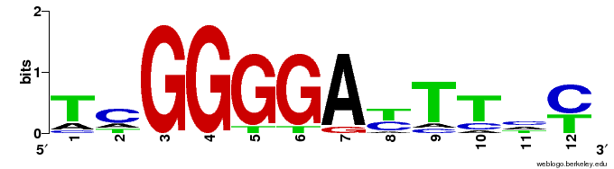
Motif Logo
A: .2 .2 0 0 0 0 .9 .1 .1 .1 .3 0
C: .1 .6 0 0 0 0 0 .4 .1 .2 .4 .6
Profile(Motifs) G: 0 0 1 1 .9 .9 .1 0 0 0 0 0
T: .7 .2 0 0 .1 .1 0 .5 .8 .7 .3 .4
Consensus(Motifs) T C G G G G A T T T C C
motif logo
The total height of 4 nucleotides in each position: 2 - entropy.
The relative sizes of 4 nucleotides in each position: frequencies in the column.

Slide 29
The Motif Finding Problem
Motif Finding Problem: Given a collection of strings, find a set of k-mers, one from each string, that minimizes the score of the resulting motif.
Input: A collection of strings Dna and an integer k.
Output: A collection Motifs of k-mers, one from each string in Dna, maximizing Score(Motifs) among all possible choices of k-mers.
Notes:
pause

Slide 30
Brute Force Motif Search
Brute Force Motif Search: Compute score of every possible choice of k-mers in Dna.

Slide 31
Brute Force Motif Search
Brute Force Motif Search: Compute score of every possible choice of k-mers in Dna.
STOP and Think: What is this approach’s runtime?

Slide 32
Brute Force Motif Search
Brute Force Motif Search: Compute score of every possible choice of k-mers in Dna.
STOP and Think: What is this approach’s runtime?
Say that Dna consists of t strings of length n:
There are (n – k + 1)^{t} different choices of Motifs
Scoring the matrix requires k*t steps.

Slide 33
Brute Force Motif Search
Brute Force Motif Search: Compute score of every possible choice of k-mers in Dna.
STOP and Think: What is this approach’s runtime?
Say that Dna consists of t strings of length n:
There are (n – k + 1)^{t} different choices of Motifs
Scoring the matrix requires k*t steps.
Overall runtime ~ O(n^{t} * k * t) – too slow!
Notes:
N^{t}
^{pause}

Slide 34
Changing Our Perspective
T C G G G G g T T T T t
c C G G t G A c T T a C
a C G G G G A T T T t C
T t G G G G A c T T t t
a a G G G G A c T T C C
T t G G G G A c T T C C
T C G G G G A T T c a t
T C G G G G A T T c C t
T a G G G G A a c T a C
T C G G G t A T a a C C
Motifs
Consensus(Motifs)
T C G G G G A T T T C C

Slide 35

Changing Our Perspective
T C G G G G g T T T T t
c C G G t G A c T T a C
a C G G G G A T T T t C
T t G G G G A c T T t t
a a G G G G A c T T C C
T t G G G G A c T T C C
T C G G G G A T T c a t
T C G G G G A T T c C t
T a G G G G A a c T a C
T C G G G t A T a a C C
Motifs
Consensus(Motifs)
T C G G G G A T T T C C

Slide 36
Changing Our Perspective
T C G G G G g T T T T t
c C G G t G A c T T a C
a C G G G G A T T T t C
T t G G G G A c T T t t
a a G G G G A c T T C C
T t G G G G A c T T C C
T C G G G G A T T c a t
T C G G G G A T T c C t
T a G G G G A a c T a C
T C G G G t A T a a C C
Motifs
Consensus(Motifs)
T C G G G G A T T T C C
Score(Motifs)
7 + 6 + 10 + 10 + 9 + 9 + 9 + 5 + 8 + 7 + 4 + 6 = 90

Slide 37
Changing Our Perspective
T C G G G G g T T T T t
c C G G t G A c T T a C
a C G G G G A T T T t C
T t G G G G A c T T t t
a a G G G G A c T T C C
T t G G G G A c T T C C
T C G G G G A T T c a t
T C G G G G A T T c C t
T a G G G G A a c T a C
T C G G G t A T a a C C
3
4
2
4
3
2
3
2
4
3
Motifs
Consensus(Motifs)
T C G G G G A T T T C C
Score(Motifs)
3 + 4 + 0 + 0 + 1 + 1 + 1 + 5 + 2 + 3 + 6 + 4 = 30

Slide 38
Changing Our Perspective
T C G G G G g T T T T t
c C G G t G A c T T a C
a C G G G G A T T T t C
T t G G G G A c T T t t
a a G G G G A c T T C C
T t G G G G A c T T C C
T C G G G G A T T c a t
T C G G G G A T T c C t
T a G G G G A a c T a C
T C G G G t A T a a C C
3
4
2
4
3
2
3
2
4
3
Motifs
Consensus(Motifs)
T C G G G G A T T T C C
Score(Motifs)
3 + 4 + 0 + 0 + 1 + 1 + 1 + 5 + 2 + 3 + 6 + 4 = 30
Number of lowercase symbols in a row = Hamming distance between that row and Consensus(Motifs).

Slide 39
The Equivalent Motif Finding Problem
Equivalent Motif Finding Problem: Given a collection of strings, find a pattern and a collection of k-mers (one from each string) that minimizes the distance between all possible patterns and all possible collections of k-mers.
Input: A collection of strings Dna and an integer k.
Output: A k-mer Pattern and a collection of k-mers Motifs, one from each string in Dna, minimizing d(Pattern, Motifs) among all possible choices of Pattern and Motifs.

Slide 40
The Equivalent Motif Finding Problem
Equivalent Motif Finding Problem: Given a collection of strings, find a pattern and a collection of k-mers (one from each string) that minimizes the distance between all possible patterns and all possible collections of k-mers.
Input: A collection of strings Dna and an integer k.
Output: A k-mer Pattern and a collection of k-mers Motifs, one from each string in Dna, minimizing d(Pattern, Motifs) among all possible choices of Pattern and Motifs.
Notes:
N^ t

Slide 41
Motif Finding Problem == Median String Problem
The Motif Finding is a maximization problem while Median String is a minimization problem
One is sequence-based and the other pattern-based.
However, the Motif Finding problem and Median String problem are computationally equivalent
Need to show that minimizing TotalDistance is equivalent to maximizing Score, with the median string as the consensus string

Slide 42
We are looking for the same thing
l
a G g t a c T t
C c A t a c g t
Alignment a c g t T A g t
a c g t C c A t
C c g t a c g G
_________________
A 3 0 1 0 3 1 1 0
Profile C 2 4 0 0 1 4 0 0
G 0 1 4 0 0 0 3 1
T 0 0 0 5 1 0 1 4
_________________
Consensus a c g t a c g t
Score 3+4+4+5+3+4+3+4
TotalDistance 2+1+1+0+2+1+2+1
Sum 5 5 5 5 5 5 5 5
At any column i Score_{i} + TotalDistance_{i} = t
Because there are l columns
Score + TotalDistance = l * t
Rearranging:
Score = l * t - TotalDistance
l * t is constant and thus the minimization of the right side is equivalent to the maximization of the left side
t

Slide 43
Have We Just Made Our Task More Difficult?
Motif Finding Problem. Find a set of k-mers Motifs, one from each sequence in Dna, minimizing Score(Motifs).
Equivalent Motif Finding Problem. Find k-mer Pattern AND a set of k-mers Motifs, one from each sequence in Dna, minimizing d(Pattern, Motifs).
The key insight for solving the Equivalent Motif Finding Problem:
given Pattern, we can quickly find Motifs minimizing d(Pattern,Motifs).
No need to explore all Motifs like in Motif Finding Problem!
Instead, the Median String Problem explores all k-mers Pattern
Notes:
4^k

Slide 44
Outline
From Implanted Patterns to Regulatory Motifs
Implanting Patterns into Strings
Do We Have a Clock Gene?
Implanted Motif Problem
Motif Finding Problem (Music Break)
Median String Problem
Greedy Motif Search
How Rolling Dice Helps Us Find Regulatory Motifs
Randomized Motif Search
How do Bacteria Hibernate?
Gibbs Sampling
Pseudocounts

Slide 45
Distance between a k-mer and a (longer) String
Distance d(GATTCTCA, GCAAAGACGCTGACCAA) = ?
G A T T C T C A
| | | | | | |
G C A A A G A C G C T G A C C A A
Distance: 7
d(Pattern, String):
minimum distance between Pattern and all k-mers in String

Slide 46
Distance between a k-mer and a (longer) String
d(GATTCTCA, GCAAAGACGCTGACCAA) = ?
G A T T C T C A
| | | | | |
G C A A A G A C G C T G A C C A A
Distance: 7 6
d(Pattern, String):
minimum distance between Pattern and all k-mers in String

Slide 47
Distance between a k-mer and a (longer) String
d(GATTCTCA, GCAAAGACGCTGACCAA) = ?
G A T T C T C A
| | | | | | |
G C A A A G A C G C T G A C C A A
Distance: 7 6 7
d(Pattern, String):
minimum distance between Pattern and all k-mers in String

Slide 48
Distance between a k-mer and a (longer) String
d(GATTCTCA, GCAAAGACGCTGACCAA) = ?
G A T T C T C A
| | | | |
G C A A A G A C G C T G A C C A A
Distance: 7 6 7 5
d(Pattern, String):
minimum distance between Pattern and all k-mers in String

Slide 49
Distance between a k-mer and a (longer) String
d(GATTCTCA, GCAAAGACGCTGACCAA) = ?
G A T T C T C A
| | | | | | | |
G C A A A G A C G C T G A C C A A
Distance: 7 6 7 5 8
d(Pattern, String):
minimum distance between Pattern and all k-mers in String

Slide 50
Distance between a k-mer and a (longer) String
d(GATTCTCA, GCAAAGACGCTGACCAA) = ?
G A T T C T C A
| | |
G C A A A G A C G C T G A C C A A
Distance: 7 6 7 5 8 3
d(Pattern, String):
minimum distance between Pattern and all k-mers in String

Slide 51
Distance between a k-mer and a (longer) String
d(GATTCTCA, GCAAAGACGCTGACCAA) = ?
G A T T C T C A
| | | | | | | |
G C A A A G A C G C T G A C C A A
Distance: 7 6 7 5 8 3 8
d(Pattern, String):
minimum distance between Pattern and all k-mers in String

Slide 52
Distance between a k-mer and a (longer) String
d(GATTCTCA, GCAAAGACGCTGACCAA) = ?
G A T T C T C A
| | | | | | |
G C A A A G A C G C T G A C C A A
Distance: 7 6 7 5 8 3 8 7
d(Pattern, String):
minimum distance between Pattern and all k-mers in String

Slide 53
Distance between a k-mer and a (longer) String
d(GATTCTCA, GCAAAGACGCTGACCAA) = ?
G A T T C T C A
| | | |
G C A A A G A C G C T G A C C A A
Distance: 7 6 7 5 8 3 8 7 4
d(Pattern, String):
minimum distance between Pattern and all k-mers in String

Slide 54
Distance between a k-mer and a (longer) String
d(GATTCTCA, GCAAAGACGCTGACCAA) = ?
G A T T C T C A
| | | | | |
G C A A A G A C G C T G A C C A A
Distance: 7 6 7 5 8 3 8 7 4 6
d(Pattern, String):
minimum distance between Pattern and all k-mers in String

Slide 55
Distance between a k-mer and a (longer) String
d(GATTCTCA, GCAAAGACGCTGACCAA) = 3
G A T T C T C A
| | |
G C A A A G A C G C T G A C C A A
Distance: 7 6 7 5 8 3 8 7 4 6
d(Pattern, String):
minimum distance between Pattern and all k-mers in String

Slide 56
Distance between a k-mer and a Set of Strings
Distance between a k-mer and a set of strings Dna = {Dna₁, … , DNA_{t}}:
d(k-mer, Dna) = ∑ d(k-mer, Dna_{i})
all strings in Dna
ttaccttAAc 1
gAtAtctgtc 1
Acggcgttcg 2
ccctAAAgag 0
cgtcAgAggt 1
d(AAA, Dna)= 5
Pattern = AAA
A median string for the set of strings Dna:
a k-mer minimizing distance d(k-mer, Dna) over all possible k-mers.

Slide 57
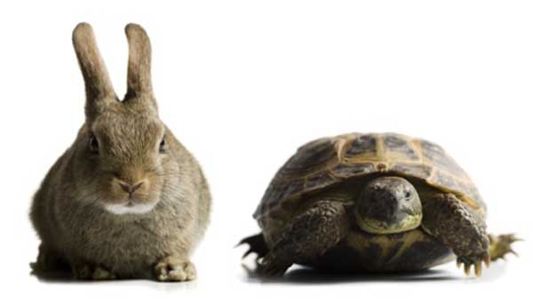
Median String Problem
Median String Problem. Finding a median string.
Input: A set of sequences Dna and an integer k.
Output: A k-mer minimizing distance d(k-mer, Dna) among all k-mers.
MedianString(Dna, k)
best-k-mer ← AAA · · · AA
for each k-mer from AAA · · · AA to TTT · · · TT
if d(k-mer, Dna) < distance(best-k-mer, Dna)
best-k-mer ← k-mer
return(best-k-mer)
Runtime: 4^{k}∙n∙t∙k (for Dna with t sequences of length n).
Motif Finding Problem
versus
Median String Problem
Runtime: n^{t} ∙k∙t
Runtime: 4^{k}∙n∙t∙k

Slide 58
Motif Finding Problem = Median String Problem
Motif Finding Problem
versus
Median String Problem
Runtime: n^{t} ∙k∙t
Runtime: 4^{k}∙n∙t∙k
Although MedianString is much faster than BruteForceMotifSearch, it is still slow for large k.

Slide 59
Outline
From Implanted Patterns to Regulatory Motifs
Implanting Patterns into Strings
Do We Have a Clock Gene?
Implanted Motif Problem
Motif Finding Problem (Music Break)
Median String Problem
Greedy Motif Search
How Rolling Dice Helps Us Find Regulatory Motifs
Randomized Motif Search
How do Bacteria Hibernate?
Gibbs Sampling
Pseudocounts

Slide 60
From Motifs to Profile
T C G G G G g T T T t t
c C G G t G A c T T a C
a C G G G G A T T T t C
T t G G G G A c T T t t
Motifs a a G G G G A c T T C C
T t G G G G A c T T C C
T C G G G G A T T c a t
T C G G G G A T T c C t
T a G G G G A a c T a C
T C G G G T A T a a C C
A: .2 .2 0 0 0 0 .9 .1 .1 .1 .3 0
C: .1 .6 0 0 0 0 0 .4 .1 .2 .4 .6
Profile(Motifs) G: 0 0 1 1 .9 .9 .1 0 0 0 0 0
T: .7 .2 0 0 .1 .1 0 .5 .8 .7 .3 .4
A: 2 2 0 0 0 0 9 1 1 1 3 0
C: 1 6 0 0 0 0 0 4 1 2 4 6
Count(Motifs) G: 0 0 10 10 9 9 1 0 0 0 0 0
T: 7 2 0 0 1 1 0 5 8 7 3 4
count
of nucleotide
i in column j
frequency
of nucleotide
i in column j
T C G G G G A C T T C C
Each column of a profile represents a biased 4-sided die with A, C, G, and T on its sides. Thus, a profile corresponds to k dice.
What is the probability that k rolls of such dice generate a given string ?

Slide 61
Scoring k-mers with a Profile
Given the following Profile:
A | 1/2 | 7/8 | 3/8 | 0 | 1/8 | 0
C | 1/8 | 0 | 1/2 | 5/8 | 3/8 | 0
T | 1/8 | 1/8 | 0 | 0 | 1/4 | 7/8
G | 1/4 | 0 | 1/8 | 3/8 | 1/4 | 1/8
The probability of the consensus string:
Pr(AAACCT|Profile) = ???

Slide 62
Scoring k-mers with a Profile
Given the following Profile:
A | 1/2 | 7/8 | 3/8 | 0 | 1/8 | 0
C | 1/8 | 0 | 1/2 | 5/8 | 3/8 | 0
T | 1/8 | 1/8 | 0 | 0 | 1/4 | 7/8
G | 1/4 | 0 | 1/8 | 3/8 | 1/4 | 1/8
The probability of the consensus string:
Pr(AAACCT|Profile) =
1/2 x 7/8 x 3/8 x 5/8 x 3/8 x 7/8 = 0.033646

Slide 63
Scoring k-mers with a Profile
Given the following Profile:
A | 1/2 | 7/8 | 3/8 | 0 | 1/8 | 0
C | 1/8 | 0 | 1/2 | 5/8 | 3/8 | 0
T | 1/8 | 1/8 | 0 | 0 | 1/4 | 7/8
G | 1/4 | 0 | 1/8 | 3/8 | 1/4 | 1/8
The probability of another string:
Pr(AAACCT|Profile) = 1/2 x 7/8 x 3/8 x 5/8 x 3/8 x 7/8 = 0.033646
Pr(ATACAG |Profile) =
1/2 x 1/8 x 3/8 x 5/8 x 1/8 x 1/8 = 0.001602
The closer k-mer is to the consensus string, the larger Pr(k-mer| Profile) is.

Slide 64
What is the Profile-most probable 6-mer in CTATAAACCTTACAT?
Profile-most probable k-mer in a sequence: the k-mer with the highest
Pr(k-mer | Profile)
among all k-mers in this sequence.
A | 1/2 | 7/8 | 3/8 | 0 | 1/8 | 0
C | 1/8 | 0 | 1/2 | 5/8 | 3/8 | 0
T | 1/8 | 1/8 | 0 | 0 | 1/4 | 7/8
G | 1/4 | 0 | 1/8 | 3/8 | 1/4 | 1/8
6-mer | Prob(6-mer|Profile)
CTATAAACCTTACAT | 1/8 x 1/8 x 3/8 x 0 x 1/8 x 0 | 0
CTATAAACCTTACAT | 1/2 x 7/8 x 0 x 0 x 1/8 x 0 | 0
CTATAAACCTTACAT | 1/2 x 1/8 x 3/8 x 0 x 1/8 x 0 | 0
CTATAAACCTTACAT | 1/8 x 7/8 x 3/8 x 0 x 3/8 x 0 | 0
CTATAAACCTTACAT | 1/2 x 7/8 x 3/8 x 5/8 x 3/8 x 7/8 | .0336
CTATAAACCTTACAT | 1/2 x 7/8 x 1/2 x 5/8 x 1/4 x 7/8 | .0299
CTATAAACCTTACAT | 1/2 x 0 x 1/2 x 0 1/4 x 0 | 0
CTATAAACCTTACAT | 1/8 x 0 x 0 x 0 x 0 x 1/8 x 0 | 0
CTATAAACCTTACAT | 1/8 x 1/8 x 0 x 0 x 3/8 x 0 | 0
CTATAAACCTTACAT | 1/8 x 1/8 x 3/8 x 5/8 x 1/8 x 7/8 | .0004

Slide 65
GreedyMotifSearch
Given a set of k-mers Motif₁, … , Motif_{i-1} in the first i-1 sequences in Dna:
form Profile from them
form Motif₁, … Motif_{i-1}, Motif_{i} by adding the Profile-most probable k-mer Motif_{i} in the i-th sequence to the growing set of k-mers

Slide 66
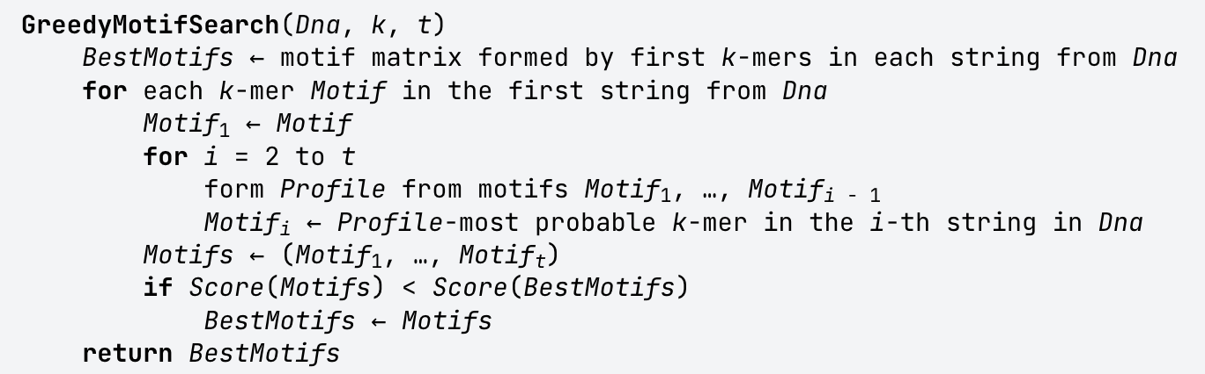
GreedyMotifSearch
Notes:
(N – k + 1) * (t - 1) * (n – k + 1)

Slide 67
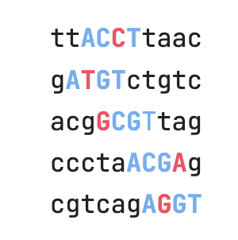
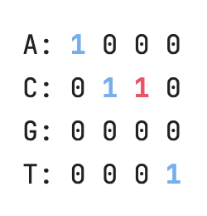
GreedyMotifSearch
Notes:
(N – k + 1) * (t - 1) * (n – k + 1)

Slide 68
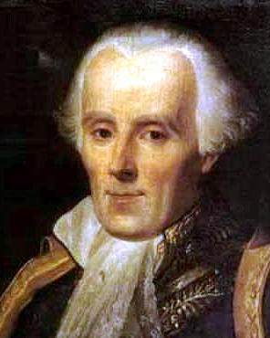
Laplace’s Rule of Succession
In small datasets, there is always a chance that a possible event does not occur (e.g., zeroes in Count matrix).
Randomized algorithms do not like zeroes and introduce pseudocounts that inflate the probabilities of rare events and eliminate empirical zero-frequencies.
Laplace calculated the probability that the sun will not rise tomorrow, given that it has risen every day for the past 5000 years (1 in 1826251)
His estimate was ridiculed because his opponents failed to understand its importance.
If we repeat an experiment that can result in a success or failure n times and get s successes, what is the probability that the next repetition will be a success?

Slide 69
Pseudocounts
If X₁, ..., X_{n+1} are conditionally independent random boolean variables (failure 0 or success 1) then:
Pr(X_{n+1}=1|X₁+…+X_{n}=s )=s/n
Pr(X_{n+1}=1|X₁+…+X_{n}=s )=(s+1)/(n+2)
Since we have the prior knowledge that both success and failure are possible, we essentially made n+2 rather than n observations since we (implicitly) observed one success and one failure before we even started the experiments.
Thus, we have made n+2 observations (known as pseudocounts) with s+1 successes.

Slide 70
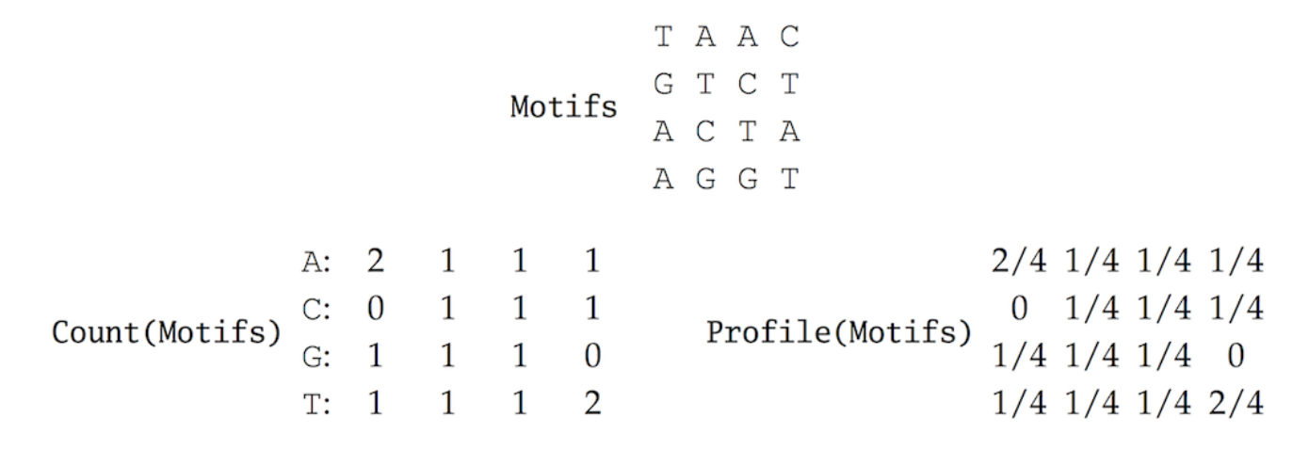
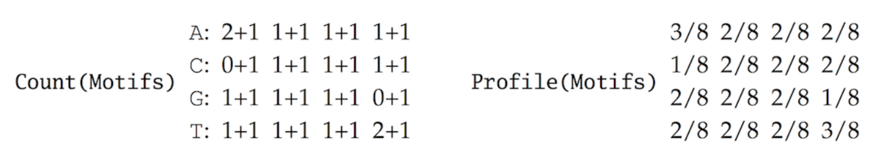
GreedyMotifSearch
Notes:
(N – k + 1) * (t - 1) * (n – k + 1)

Slide 71
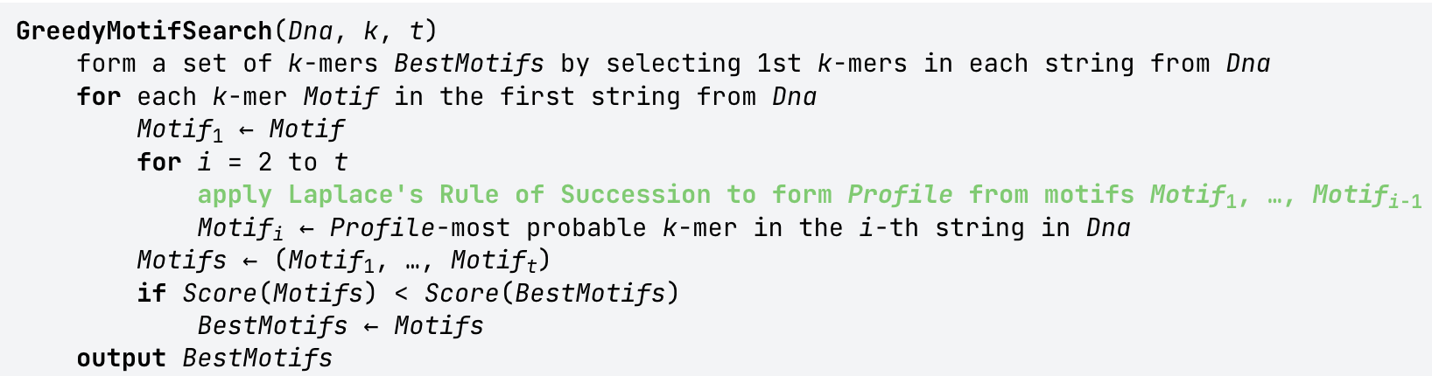
GreedyMotifSearch
Notes:
(N – k + 1) * (t - 1) * (n – k + 1)

Slide 72
Outline
From Implanted Patterns to Regulatory Motifs
Implanting Patterns into Strings
Do We Have a Clock Gene?
Implanted Motif Problem
Motif Finding Problem (Music Break)
Median String Problem
Greedy Motif Search
How Rolling Dice Helps Us Find Regulatory Motifs
Randomized Motif Search
Gibbs Sampling
Pseudocounts

Slide 73

From Motifs to Profile to Motifs to Profile to Motifs…
Given Motifs, we can construct
Profile(Motifs)
Given an arbitrary Profile and a set of sequences Dna, we can construct
Motifs(Profile, Dna)
as a set of Profile-most probable k-mers in each sequence from Dna.
Iterate!
Motifs(Profile(Motifs(Profile(Motifs),Dna)),Dna)),Dna)…

Slide 74
RandomizedMotifSearch
RandomizedMotifSearch(Dna, k, t)
randomly select k-mers Motifs = (Motif₁, … ,Motif_{t}) in each string from DNA
bestMotifs ← Motifs
while forever
Profile ← Profile(Motifs)
Motifs ← Motifs(Profile, Dna)
if Score(Motifs) < Score(bestMotifs)
bestMotifs ← Motifs
else
return(bestMotifs)
How in the World Can This Algorithm Find Anything?
When we form k-mers randomly, it results in a uniform expected Profile with every entry 1/4. Such a uniform profile is useless because it does not provide any clues about the implanted motif.

Slide 75
RandomizedMotifSearch in Action
Dna with implanted (4,1)-motif ACGT
Randomly select
Motifs (in bold)
Motifs
Profile(Motifs)
ttACCTtaac
gATGTctgtc
ccgGCGTtag
cactaACGAg
cgtcagAGGT
ttACCTtaac
gATGTctgtc
ccgGCGTtag
cactaACGAg
cgtcagAGGT
t a a c
G T c t
c c g G
a c t a
A G G T
A: 2/5 1/5 1/5 1/5
C: 1/5 2/5 1/5 1/5
G: 1/5 1/5 2/5 1/5
T: 1/5 1/5 1/5 2/5
.0016/ttAC .0016/tACC .0128/ACCT .0064/CCTt .0016/Ctta .0016/Ttaa .0016/taac
.0016/gATG .0128/ATGT .0016/TGTc .0032/GTct .0032/Tctg .0032/ctgt .0016/tgtc
.0064/ccgG .0036/cgGC .0016/gGCG .0128/GCGT .0032/CGTt .0016/Gtta .0016/Ttag
.0032/cact .0064/acta .0016/ctaA .0016/taAC .0032/aACG .0128/ACGA .0016/CGAg
.0016/cgtc .0016/gtca .0016/tcag .0032/cagA .0032/agAG .0032/gAGG .0128/AGGT
ttACCTtaac
gATGTctgtc
ccgGCGTtag
cactaACGAg
cgtcagAGGT
Motifs (Profile (Motifs), Dna)

Slide 76
How in the World Can This Algorithm Find Anything?
When we select k-mers randomly, it results in a uniform expected Profile where every entry is 1/4. Such a uniform profile is useless because it does not provide any clues about the implanted motif.
But strings in Dna are not truly random since they include implanted motifs!
These implanted motifs result in a biased expected Profile.
Where does this statistical bias point to?

Slide 77
RandomizedMotifSearch in Action
DNA with implanted (4,1)-motif ACGT
Randomly select
Motifs (in bold)
Motifs
Profile(Motifs)
ttACCTtaac
gATGTctgtc
ccgGCGTtag
cactaACGAg
cgtcagAGGT
ttACCTtaac
gATGTctgtc
ccgGCGTtag
cactaACGAg
cgtcagAGGT
t a a c
G T c t
c c g G
a c t a
A G G T
A: 2/5 1/5 1/5 1/5
C: 1/5 2/5 1/5 1/5
G: 1/5 1/5 2/5 1/5
T: 1/5 1/5 1/5 2/5
The statistical bias points in the direction of the implanted (4,1)-motif ACGT because one of the randomly selected 4-mers happened to be the implanted pattern AGGT simply by chance.

Slide 78
Outline
From Implanted Patterns to Regulatory Motifs
Implanting Patterns into Strings
Do We Have a Clock Gene?
Implanted Motif Problem
Motif Finding Problem (Music Break)
Median String Problem
Greedy Motif Search
How Rolling Dice Helps Us Find Regulatory Motifs
Randomized Motif Search
Gibbs Sampling
Pseudocounts

Slide 79
Gibbs Sampling
RandomizedMotifSearch may replace all k-mers in a single iteration and thus may potentially discard a nearly correct motif.
Gibbs sampling replaces a single k-mer at each iteration and thus moves with more caution in the space of all motifs.
ttaccttaac ttaccttaac ttaccttaac ttaccttaac
gatatctgtc gatatctgtc gatatctgtc gatatctgtc
acggcgttcg → acggcgttcg acggcgttcg → acggcgttcg
ccctaaagag ccctaaagag ccctaaagag ccctaaagag
cgtcagaggt cgtcagaggt cgtcagaggt cgtcagaggt
RandomizedMotifSearch GibbsSampler
(may change all k-mers in 1 iteration) (changes a single k-mer in 1 iteration)

Slide 80
GibbsSampler in Action
Randomly select
Motifs (in bold)
Randomly remove a k-mer in Motifs
Motifs matrix
ttACCTtaac
gATGTctgtc
ccgGCGTtag
cactaACGAg
cgtcagAGGT
ttACCTtaac
gATGTctgtc
ccgGCGTtag
cactaACGAg
cgtcagAGGT
ttACCTtaac
gATGTctgtc
----------
cactaACGAg
cgtcagAGGT
t a a c
G T c t
----------------
a c t a
A G G T
A: 2 1 1 1
C: 0 1 1 1
G: 1 1 1 0
T: 1 1 1 2
Choose a new starting position in the deleted sequence based on rolling the die
ITERATE
Count matrix
Calculate the probabilities of all k-mers in the deleted string ccgGCGTtag
Profile matrix
A: 2/4 1/4 1/4 1/4
C: 0 1/4 1/4 1/4
G: 1/4 1/4 1/4 0
T: 1/4 1/4 1/4 2/4
0 (ccgG) 0 (cgGC) 0 (gGCG) 1/128 (GCGT) 0 (CGTt) 1/256 (GTta) 0 (Ttag)
Roll a 7-sided die with probabilities of sides proportional to probabilities of k-mers

Slide 81
Gibbs Sampler Outline
Form Motifs by randomly selecting a k-mer in each sequence
Randomly choose one of selected k-mers (from RemovedSequence) and remove it from Motifs.
Create Profile from the remaining k-mers in Motifs.
For each k-mer in RemovedSequence, calculate Pr(k-mer|Profile) resulting in n-k+1 probabilities: p₁,p₂, …,p_{n-k+1.}
Roll a die (with n-k+1 sides) where probability of ending up at side i is proportional to p_{i}.
Choose a new starting position based on rolling the die. Add the k-mer starting at this position in RemovedSequence to Motifs.
Repeat steps 2-6.

Slide 82
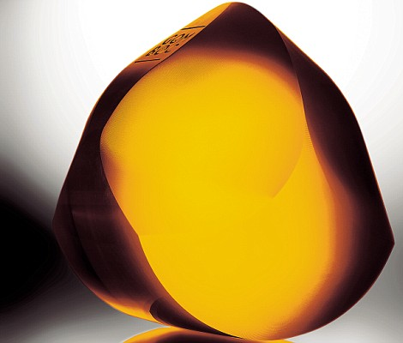
Gibbs Sampler in Action
Randomly select
Motifs (in bold)
Randomly remove a k-mer in Motifs
Motifs matrix
ttACCTtaac
gATGTctgtc
ccgGCGTtag
cactaACGAg
cgtcagAGGT
ttACCTtaac
gATGTctgtc
----------
cactaACGAg
cgtcagAGGT
t a a c
G T c t
----------------
a c t a
A G G T
A: 2 1 1 1
C: 0 1 1 1
G: 1 1 1 0
T: 1 1 1 2
Count matrix
Calculate the probabilities of all k-mers in the deleted string ccgGCGTtag
Profile matrix
A: 2/4 1/4 1/4 1/4
C: 0 1/4 1/4 1/4
G: 1/4 1/4 1/4 0
T: 1/4 1/4 1/4 2/4
0 (ccgG) 0 (cgGC) 0 (gGCG) 1/128 (GCGT) 0 (CGTt) 1/256 (GTta) 0 (Ttag)
Should we roll a two-sided die???

Slide 83
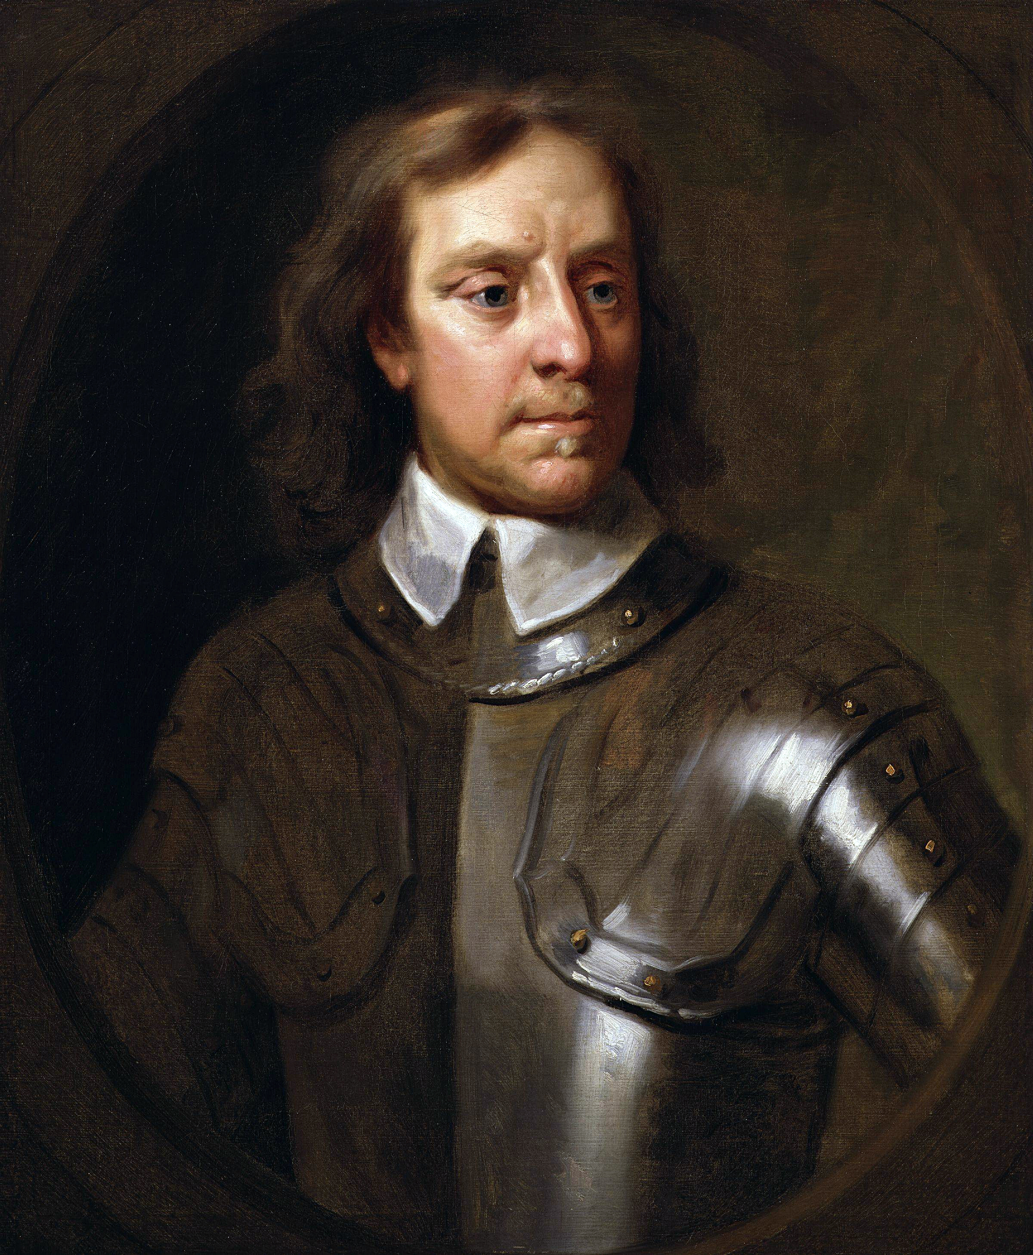
Cromwell’s Rule
Oliver Cromwell made an appeal to the Church of Scotland, urging them to see the error of their alliance with the English royalists:
I beseech you, in the bowels of Christ, think it possible that you may be mistaken.
Cromwell's rule: the use of probabilities of 0 or 1 should be avoided.
We should leave a little probability that the sun will not rise tomorrow.

Slide 84
Outline
From Implanted Patterns to Regulatory Motifs
Implanting Patterns into Strings
Do We Have a Clock Gene?
Implanted Motif Problem
Motif Finding Problem (Music Break)
Median String Problem
Greedy Motif Search
How Rolling Dice Helps Us Find Regulatory Motifs
Randomized Motif Search
How do Bacteria Hibernate?
Gibbs Sampling
Pseudocounts

Slide 85
Laplace’s Rule of Succession
In small datasets, there is always a chance that a possible event does not occur (e.g., zeroes in Count matrix).
Randomized algorithms do not like zeroes and introduce pseudocounts that inflate the probabilities of rare events and eliminate empirical zero-frequencies.
Laplace calculated the probability that the sun will not rise tomorrow, given that it has risen every day for the past 5000 years (1 in 1826251)
His estimate was ridiculed because his opponents failed to understand its importance.
If we repeat an experiment that can result in a success or failure n times and get s successes, what is the probability that the next repetition will be a success?

Slide 86
Pseudocounts
If X₁, ..., X_{n+1} are conditionally independent random boolean variables (failure 0 or success 1) then:
Pr(X_{n+1}=1|X₁+…+X_{n}=s )=s/n
Pr(X_{n+1}=1|X₁+…+X_{n}=s )=(s+1)/(n+2)
Since we have the prior knowledge that both success and failure are possible, we essentially made n+2 rather than n observations since we (implicitly) observed one success and one failure before we even started the experiments.
Thus, we have made n+2 observations (known as pseudocounts) with s+1 successes.

Slide 87
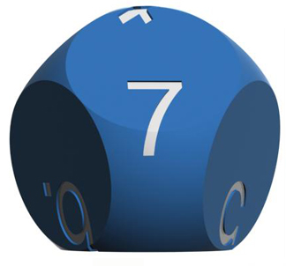
What would Laplace Do to Get Rid of Zeroes?
ttACCTtaac
gATGTctgtc
ccgGCGTtag
cactaACGAg
cgtcagAGGT
t a a c
G T c t
----------------
a c t a
A G G T
ttACCTtaac
gATGTctgtc
ccgGCGTtag
cactaACGAg
cgtcagAGGT
ttACCTtaac
gATGTctgtc
----------
cactaACGAg
cgtcagAGGT
A: 2 1 1 1
C: 0 1 1 1
G: 1 1 1 0
T: 1 1 1 2
A: 2+1 1+1 1+1 1+1
C: 0+1 1+1 1+1 1+1
G: 1+1 1+1 1+1 0+1
T: 1+1 1+1 1+1 2+1
Choose a new starting position in the deleted sequence based on rolling the die
Update
Count Matrix with
pseudocounts
Count matrix
A: 3/8 2/8 2/8 2/8
C: 1/8 2/8 2/8 2/8
G: 2/8 2/8 2/8 1/8
T: 2/8 2/8 2/8 3/8
Calculate the probabilities of all 4-mers in the deleted string ccgGCGTtag
A: 2/4 1/4 1/4 1/4
C: 0 1/4 1/4 1/4
G: 1/4 1/4 1/4 0
T: 1/4 1/4 1/4 2/4
Recalculate the probabilities of all 4-mers in the deleted string ccgGCGTtag
Update
Profile Matrix
Profile matrix
1/1024 (ccgG) 2/1024 (cgGC) 2/1024 (gGCG) 6/1024 (GCGT) 3/1024 (CGTt) 4/1024 (GTta) 2/1024 (Ttag)
0 (ccgG) 0 (cgGC) 0 (gGCG) 1/128 (GCGT) 0 (CGTt) 0 (GTta) 0 (Ttag)
Roll a 7-sided rather than 2-sided die!

Slide 88
Gibbs Sampler Continues
Randomly select
Motifs (in bold)
Randomly remove a k-mer in Motifs
Motifs matrix
ttACCTtaac
gATGTctgtc
ccgGCGTtag
cactaACGAg
cgtcagAGGT
ttACCTtaac
gATGTctgtc
ccgGCGTtag
cactaACGAg
cgtcagAGGT
----------
gATGTctgtc
ccgGCGTtag
cactaACGAg
cgtcagAGGT
-------------
G T c t
G C G T
a c t a
A G G T
A: 2 0 0 1
C: 0 2 1 0
G: 2 1 2 0
T: 0 1 1 3
A: 2+1 0+1 0+1 1+1
C: 0+1 2+1 1+1 0+1
G: 2+1 1+1 2+1 0+1
T: 0+1 1+1 1+1 3+1
Choose a new starting position in the deleted sequence based on rolling the die
Count matrix
Pseudocount Matrix
Calculate the probabilities of all k-mers in the deleted string ttACCTtaac
Construct Profile using Laplace’s Rule
A: 3/8 1/8 1/8 2/8
C: 1/8 3/8 2/8 1/8
G: 3/8 2/8 3/8 1/8
T: 1/8 2/8 2/8 4/8
2/4096 (ttAC) 2/4096 (tACC) 72/4096 (ACCT) 24/4096 (CCTt) 8/4096 (CTta) 4/4096 (Ttaa) 1/4096 (taac)
Roll a 7-sided die

Slide 89
Gibbs Sampler Continues and Continues
Randomly select
Motifs (in bold)
Randomly remove a k-mer in Motifs
Motifs matrix
ttACCTtaac
gATGTctgtc
ccgGCGTtag
cactaACGAg
cgtcagAGGT
ttACCTtaac
gATGTctgtc
ccgGCGTtag
cactaACGAg
cgtcagAGGT
ttACCTtaac
gATGTctgtc
ccgGCGTtag
----------
cgtcagAGGT
A C C T
G T c t
G C G T
-------------
A G G T
We have already captured four out of five correct 4-mers and will almost surely find all implanted motifs at one of the next iterations.
A: 2 0 0 0
C: 0 2 2 0
G: 2 1 2 0
T: 0 1 0 4
A: 2+1 0+1 0+1 0+1
C: 0+1 2+1 2+1 0+1
G: 2+1 1+1 2+1 0+1
T: 0+1 1+1 0+1 4+1
Choose a new starting position in the deleted sequence based on rolling the die
Pseudocount matrix
Count matrix
Calculate the probabilities of all k-mers in the deleted string ttACCTtaac
Create Profile using Laplace’s Rule
A: 3/8 1/8 1/8 1/8
C: 1/8 3/8 3/8 1/8
G: 3/8 2/8 3/8 1/8
T: 1/8 2/8 1/8 5/8
2/4096 (ttAC) 2/4096 (tACC) 72/4096 (ACCT) 24/4096 (CCTt) 8/4096 (CTta) 4/4096 (Ttaa) 1/4096 (taac)
Roll a 7-sided die

Slide 90
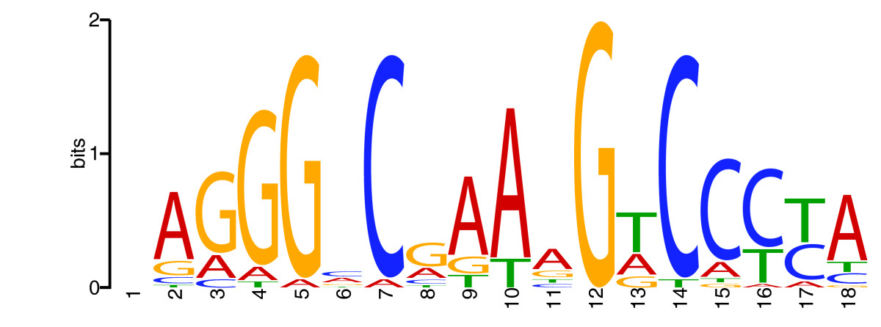
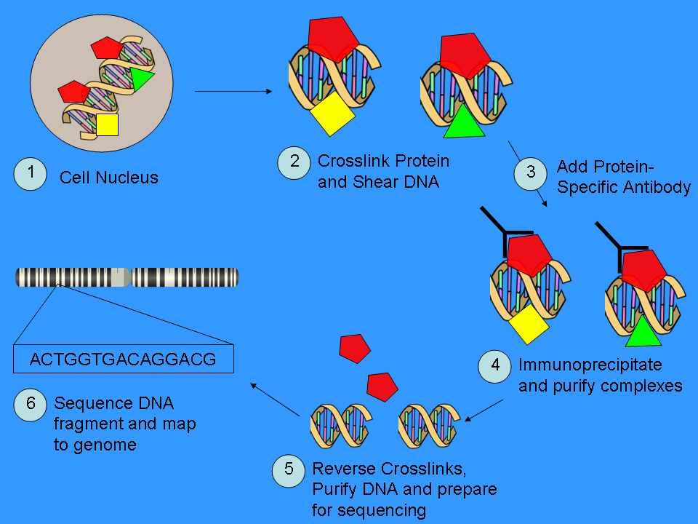
The Challenge of Predicting Degenerative Motifs
CGGGGACCTACGGCCCTAGC
Even the best motif finding algorithms fail to find some highly degenerative motifs, e.g., (15,5)-motifs are nearly impossible to find if they are randomly inserted in 1000-nucleotide long random strings.
We can still solve the Implanted Motif Problem but it will find irrelevant 15-mers
ChIP Sequencing provides an experimental solution to this problem by reducing the length of sequences to search for motifs. For example, if (15,5)-motif is inserted in 100-nucleotide (rather than 1000) long random strings, it will be easier to find!

Slide 91
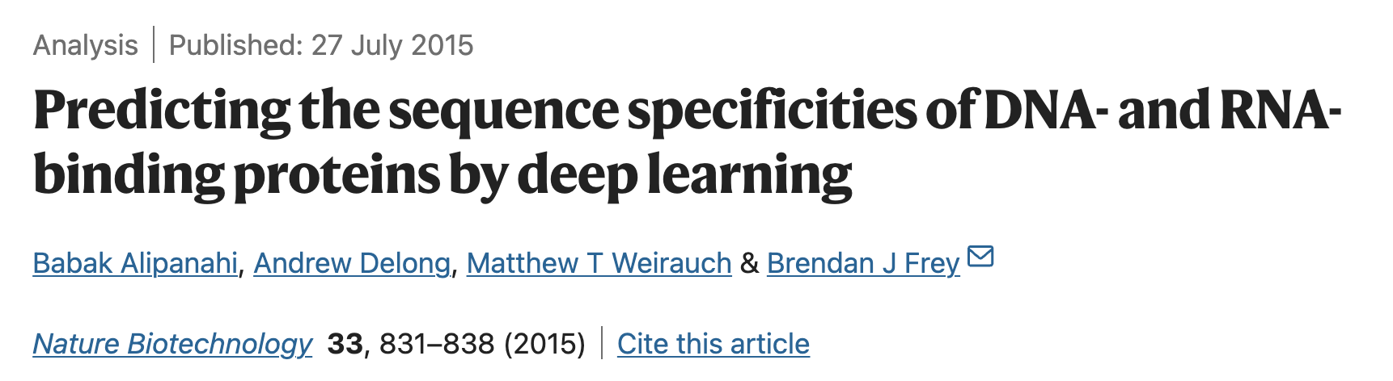
DeepBind offers a DL-based solution to motif finding

Slide 92
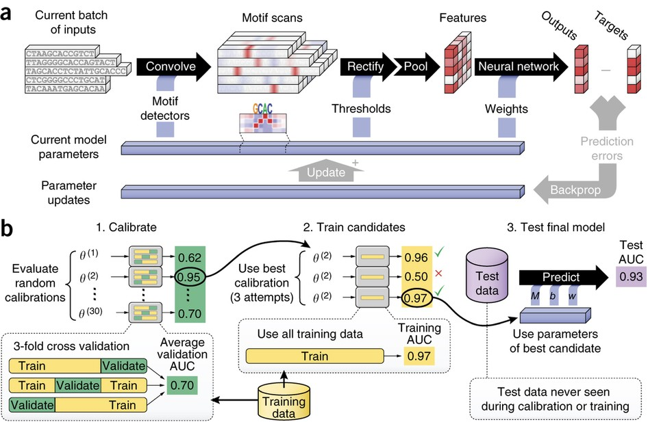
(a) Five independent sequences being processed in parallel by a single DeepBind model. The convolve, rectify, pool and neural network stages predict a separate score for each sequence using the current model parameters (Supplementary Notes, sec. 1). During the training phase, the backprop and update stages simultaneously update all motifs, thresholds and network weights of the model to improve prediction accuracy. (b) The calibration, training and testing procedure used throughout (Supplementary Notes, sec. 2).

Slide 93
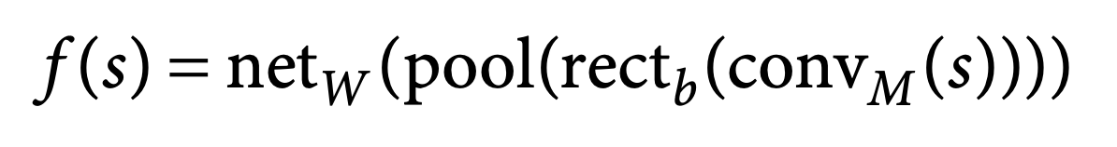

Slide 94
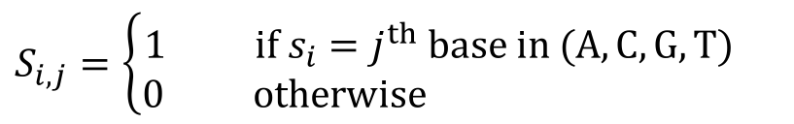
Method
One-hot encoding
Present sequence in “four channels”:
A C T T G C A G
1

Slide 95
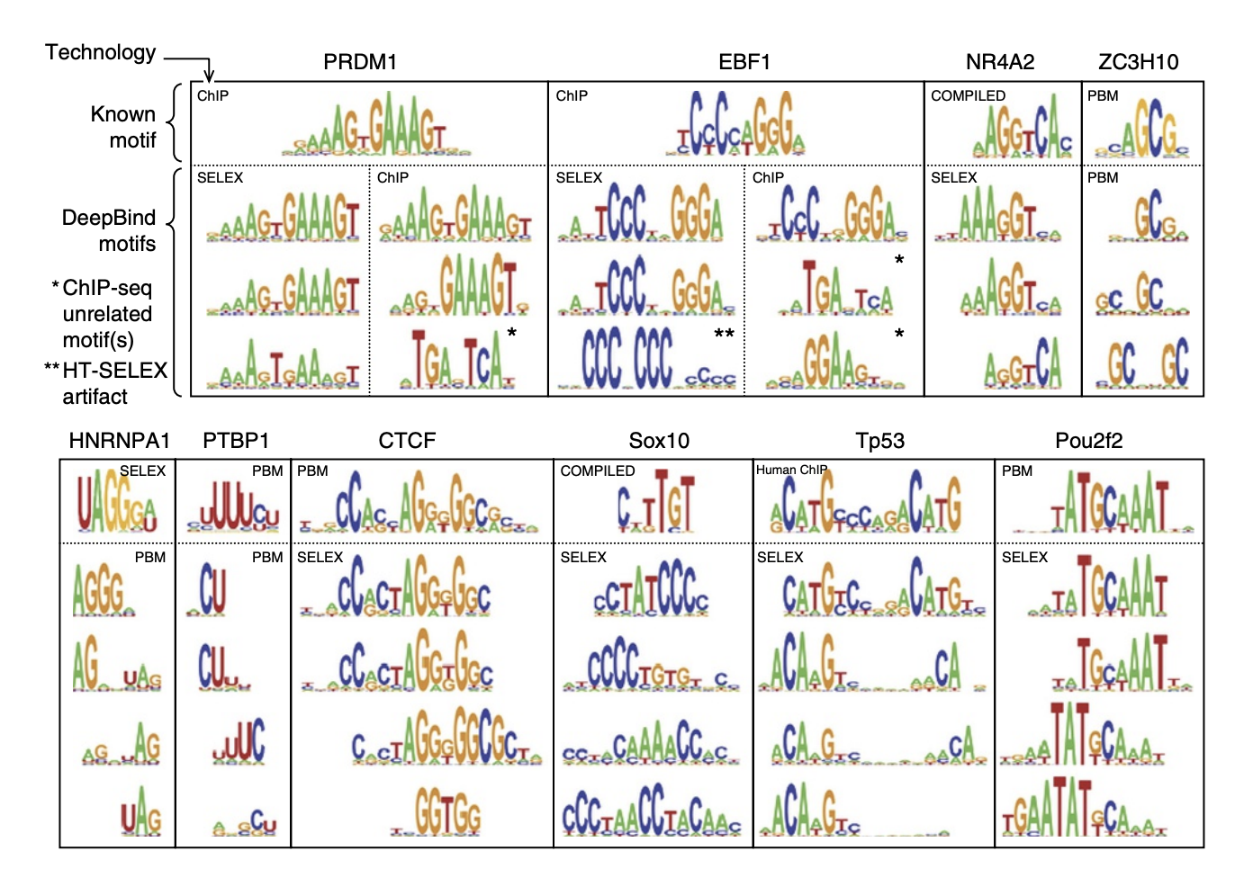
6 Comparison of motifs learned by DeepBind with known motifs

